Slide 1


Attendance QR (Week 4, Session 2)

Slide 2
Meeting 4
STM32 Peripherals
IEEE - CSULB Branch

Slide 3
Agenda
Power Pins
GPIO Pins
Pull-Up/Pull-Down Resistors
A-to-D and D-to-A Converters
Timer
Interrupt Pins
Communication Pins
Filters
Demo: PWM to Analog

Slide 4
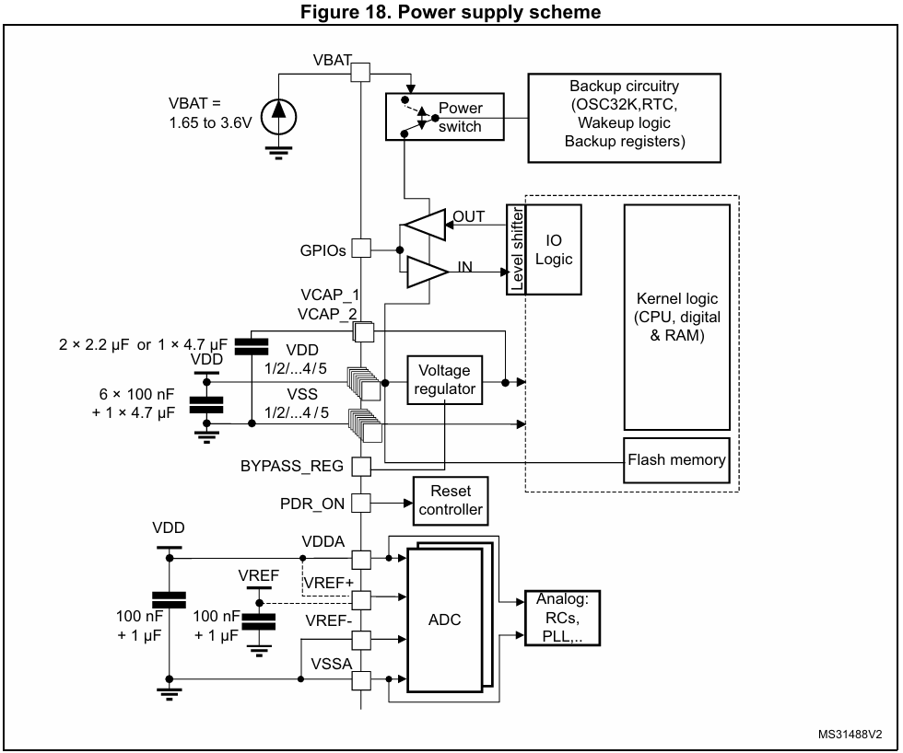
Power Pins
Different types of power pins with a high side and their corresponding ground pins.
Current flows from high voltage potential to the direction of low voltage potential, usually called GND.
VDD (similar to VCC) is the digital power supply for the core circuits -> VSS is GND).
VBAT supplies power to the real-time clock (RTC), backup registers, and wake-up logic when main power is off.

Slide 5
Power Pins (cntd.)
VDDA is used for the analog circuits such as the A-to-D (ADC) converters -> VSSA is GND.
VREF+ is positive reference voltage for the ADC while VREF- is the negative.
The high and low sides of the VDD, VBAT, VDDA, VREF+ can be connected together.
However, decoupling capacitors should be placed near their respective pins.

Slide 6
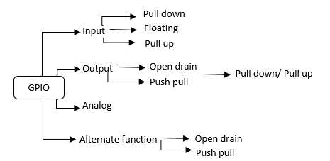
GPIO Pins
General-Purpose Input/Output (GPIO) pins are versatile and enable interaction between the STM32 and external devices/peripherals.
Basic modes include:
Input mode read state of digital or analog signal
Output mode can create digital output (0V or 3.3V)
Alternate functions can alternate between input and output (Ex. Communication protocols)

Slide 7
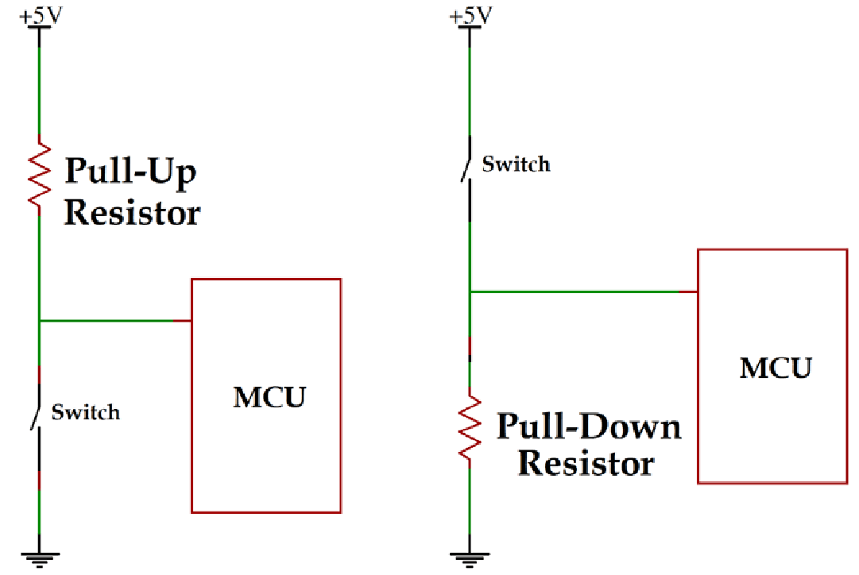
Pull-Up/Pull-Down Resistors
Floating pins are input mode pins that are not connected to anything.
Undefined voltage level with unpredictable behavior
Affected more by noise
Pull-down resistors “pull” the voltage down to a low logic level during a floating state.
Pull-up resistors “push” the voltage up to a high logic level during a floating state.
Required for certain communication protocols as well.

Slide 8

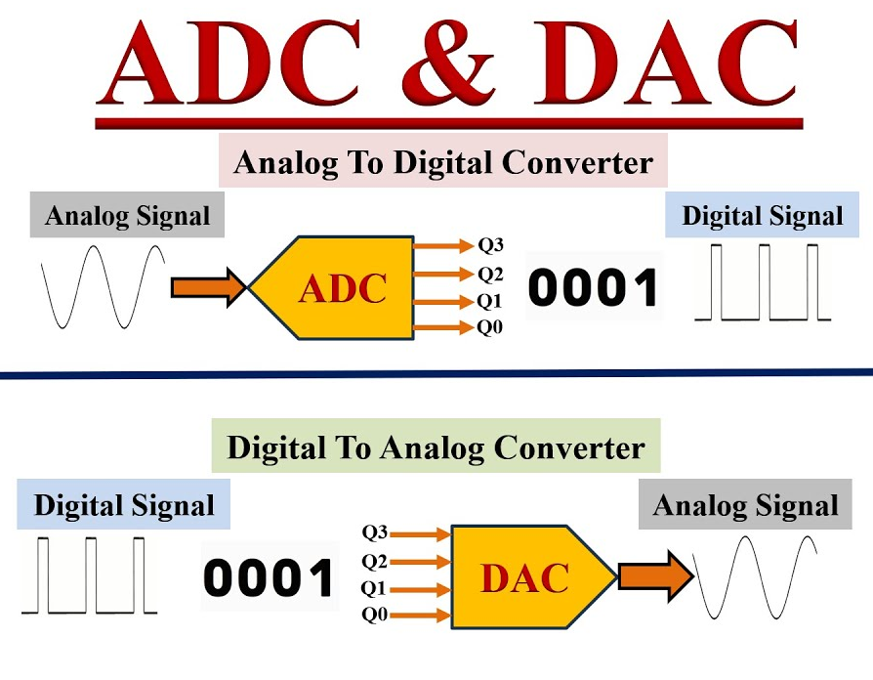
A-to-D and D-to-A Converters
The real world is analog, or continuous, rather than digital, or discrete.
Digital to analog converters (DAC) convert digital signals to an analog representation (ex. speaker).
Analog to digital converters (ADC) convert analog signals to digitized values (ex. sensor).
STM32 MCUs have internal ADCs with:
Bit resolution: Voltage is divided into steps
Steps = 2^n where n is number of bits
Sampling frequency (mega samples per second)
Channel count
Notes:
How many channels can be used at same time

Slide 9
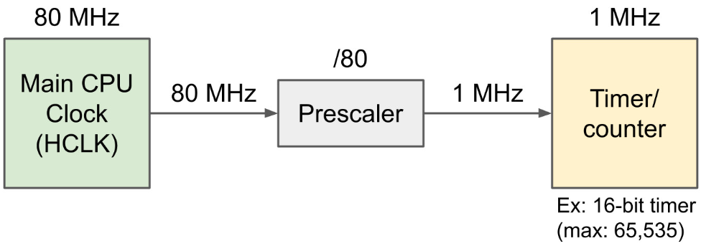
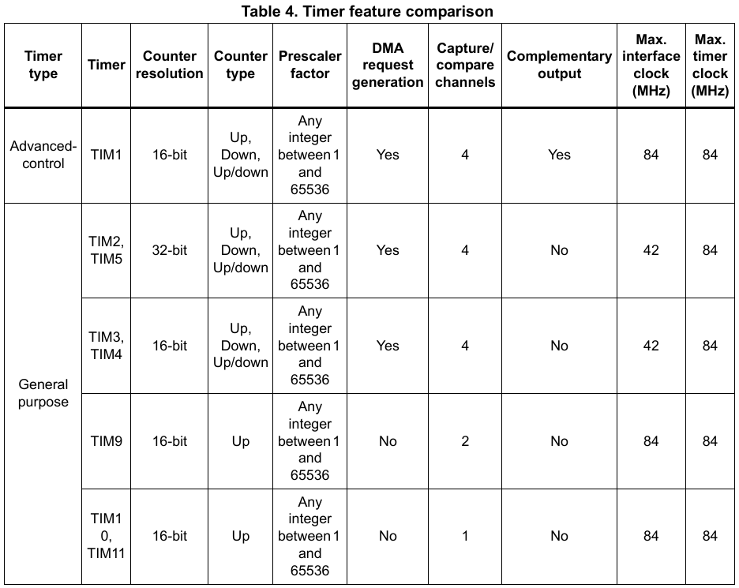
Timers
Timers, or counters, are hardware that count up or down after a clock pulse.
Can count to value based on bits (8 bit => 256 counts).
Clock frequency determines how fast it ticks, or changes.
Common modes/functions include:
Time Base – Trigger events periodically.
Output Compare – Triggers events based on the counter value compared to another specified value.
Input Capture – Stores counter value when a change in an input signal occurs.
Pulse-Width Modulation (PWM) – Shown in demo.

Slide 10
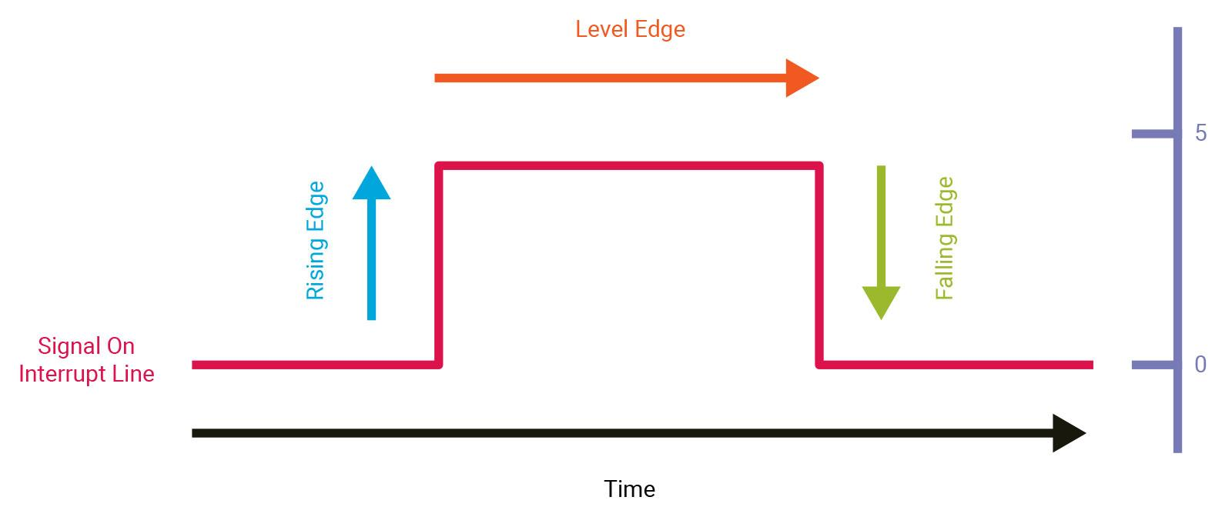
Interrupt Pins
External Interrupts allow the MCU to respond to an external signal immediately without constantly observing a pin.
Typically caused by changes in the state of a GPIO pin such as a rising or falling edge.
Example of uses:
Button press
Sensor event handling
Waking the MCU out of sleep mode
Communication protocol events

Slide 11
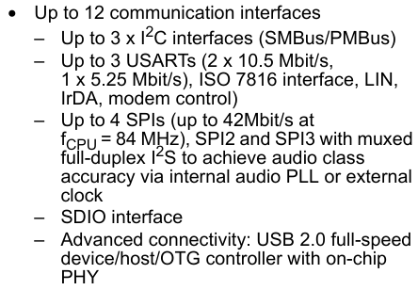
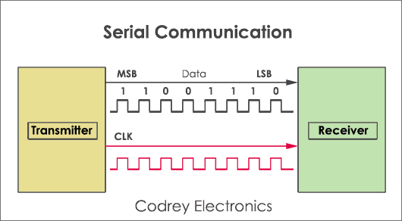
Communication Pins
Communication Protocols are a set of rules and formats enabling the transmission of data between devices.
Master (MCU) and slave (sensor) configuration.
MOSI/MISO (or CIPO/COPI) pins
Each varies based on wire count, (a)synchronous, speed, data flow direction (simplex or duplex), etc.
Common serial communication (one bit at a time) include:
UART/USART
I2C
USB
SPI (Final project)
Notes:
Talk about what makes the MCU a master (clock, communication steps)
COPI - Controller out, peripheral in

Slide 12
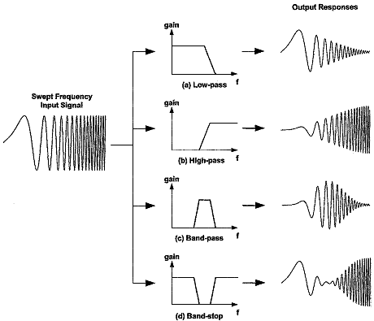
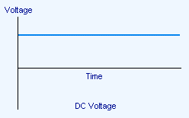
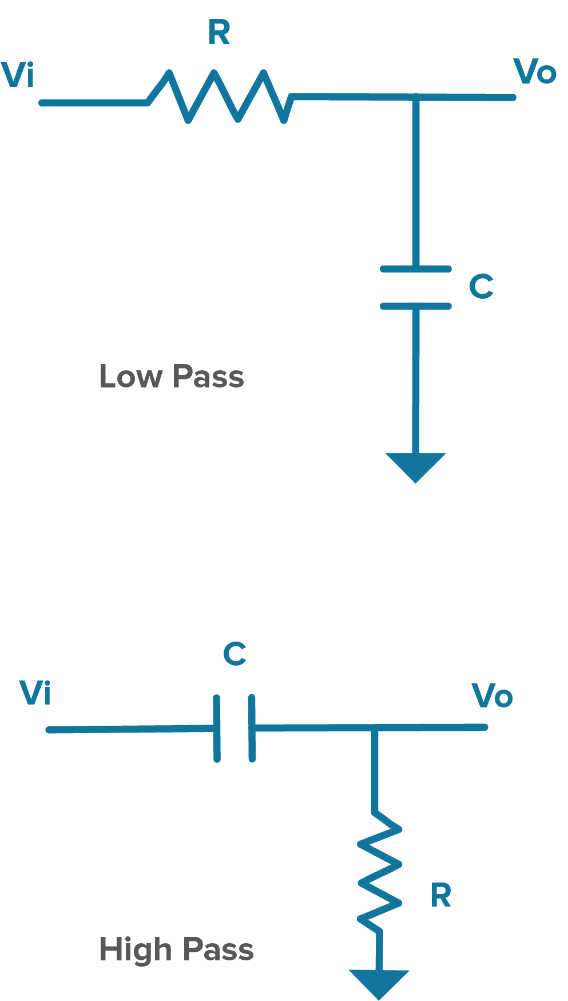
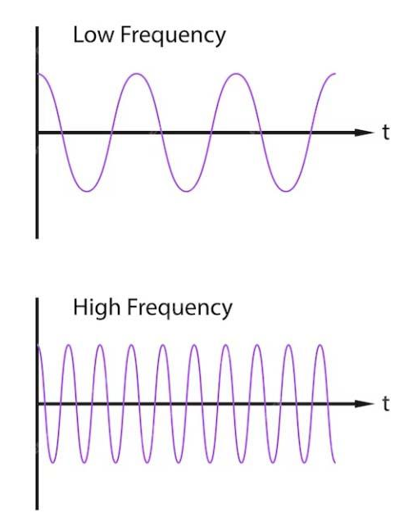
Filters
Notes:
Higher amplitude means more noise (or voltage) those frequencies pass through, lower amplitude means less noise (or voltage) those frequencies do not pass through

Slide 13
Demo: PWM to Analog
What is needed?
Software:
STM32CubeIDE
Hardware:
NUCLEO-F401
DMM/Oscilloscope
Breadboard
x5 Wires
x1 0.1µF Capacitor
x1 10kΩ Potentiometer
x1 1kΩ Resistor

Slide 14
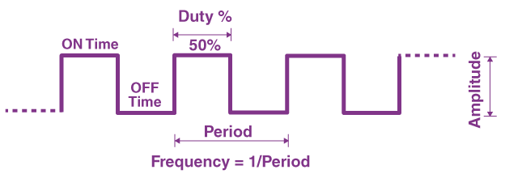
Demo: PWM to Analog (Background)
Pulse Width Modulation (PWM) is a technique to control power delivery by rapidly switching between on (3.3V) and off (0V) states while changing the time the signal is on (duty cycle).
Duty Cycle is the percentage of time that the signal is on in one period.

Slide 15
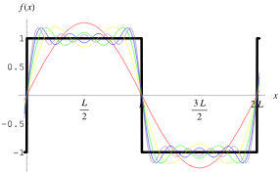
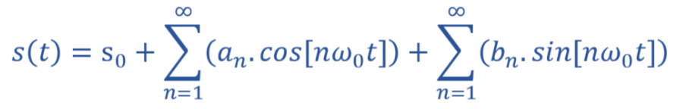
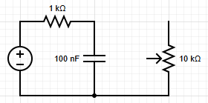
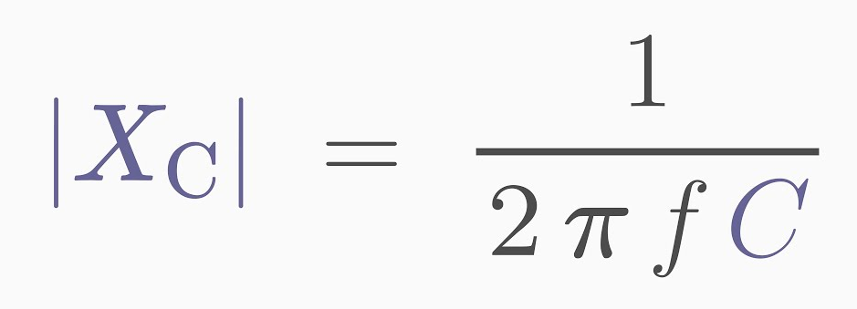
Demo: PWM to Analog (Background)
Fourier Series:
Periodic signals can be made of the summation of DC value and sinusoids of varying frequencies
Capacitor Reactance (“Resistance”):
Square Wave:
Low Pass RC Filter:

Slide 16
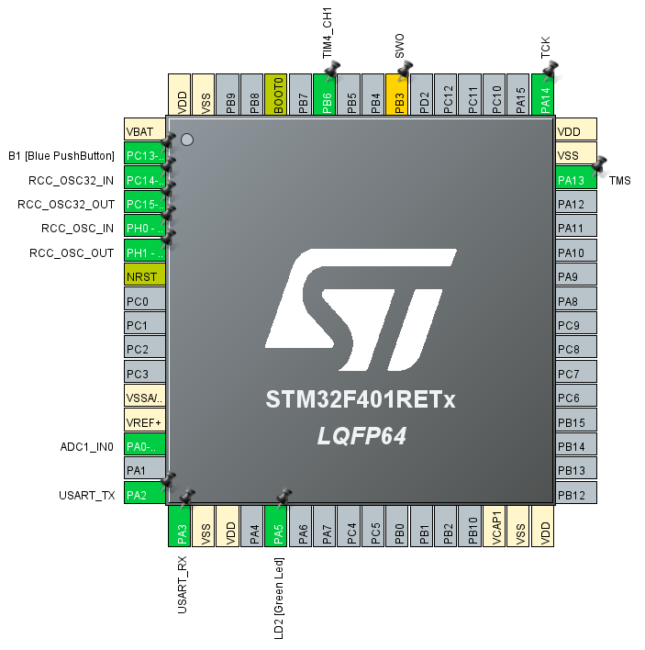
Demo: PWM to Analog
Open STM32CubeIDE -> Open Project -> Open .ioc file

Slide 17
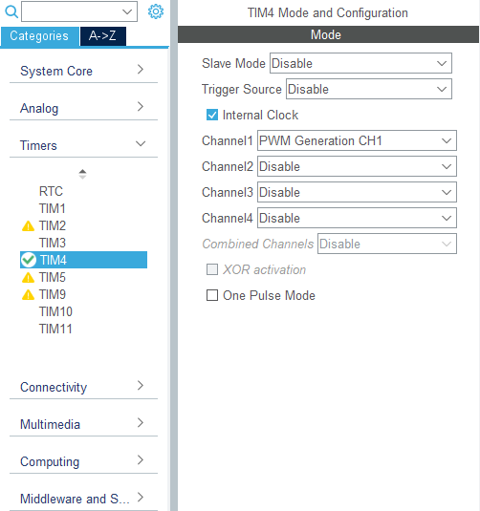
Demo: PWM to Analog
Open the timer category on left tab
In Timer tab, select TIM4
In Mode tab, select “PWM Generation CH1” in the Channel1 dropdown.
This will enable PWM on channel 1 which will show up on PB6 (D10) pin.
Check the internal clock.
Each timer has a set number of channels with some having PWM capability.

Slide 18
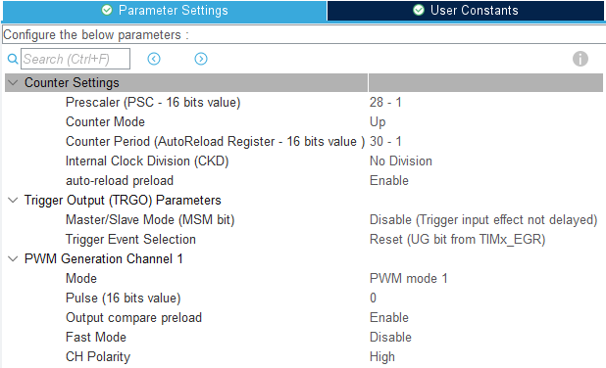
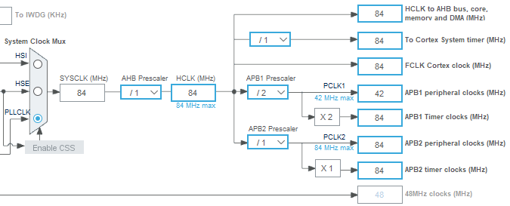
Demo: PWM to Analog
Timer clocks initially run at 84Mhz as shown in the Clock Configuration tab.
Prescalars tell how many clock cycles are used before incrementing the timer essentially scaling down the frequency. Set this to 27 (divides by 28).
Counter Period is the max number the counter reaches before starting over. Set this to 29 (resets after 30).
84Mhz / 28 / 30 = 100kHz is frequency of PWM.
Enable auto-reload preload to automatically reset the counter.
Pulse is how long the signal is “ON” and must be equal or less than the counter period.
Notes:
Explain how prescaler is like a second timer

Slide 19
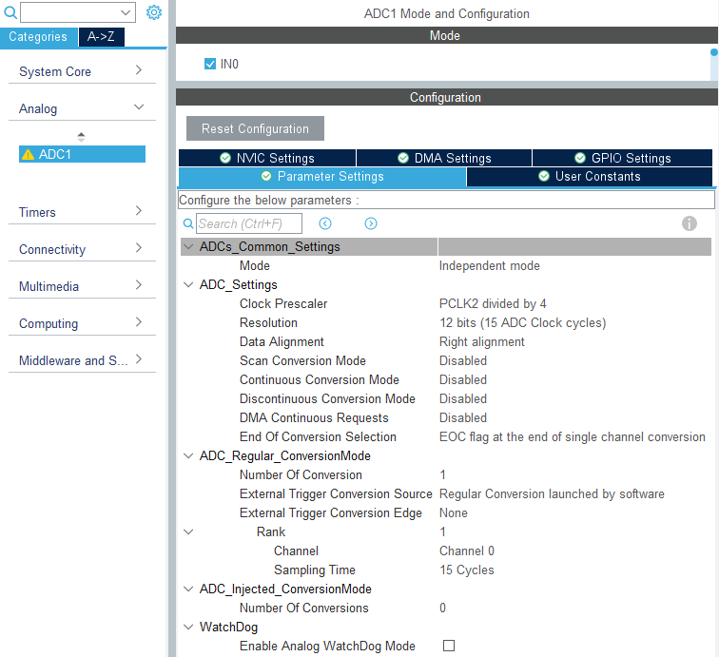
Demo: PWM to Analog
Open the Analog category on left tab
In Analog tab, select ADC1
In Mode tab, check IN0
Pin PA0 - (A0) is now being used.
Bit Resolution is 12 bits (4096 voltage steps) for this MCU.
In ADC_Regular_ConversionMode -> Rank
Change Sampling Time to 15 cycles so it matches the 15 ADC Clock cycles in the Resolution setting.
Save and generate code.

Slide 20
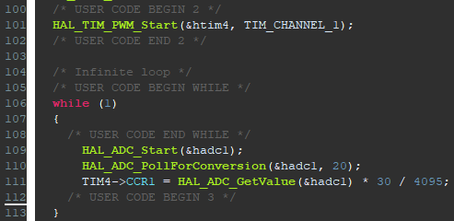
Demo: PWM to Analog
HAL_TIM_PWM_Start will start a PWM signal on a specified timer and channel.
HAL_ADC_Start will start an ADC conversion process.
HAL_ADC_PollForConversion will poll for conversion status until the conversion is complete.
HAL_ADC_GetValue will retrieve the value as an integer value between 0 to 4095.
This number is then scaled so that it fits within the range 0 to 30 (which is the PWM period).
TIM#->CCR1 will write the new pulse (time when PWM is “ON”) to the appropriate register creating a new duty cycle.
“&HADC1”
NOT HADC”i”

Slide 21
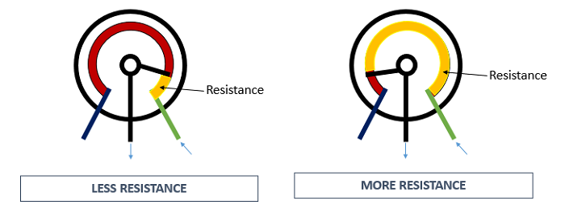
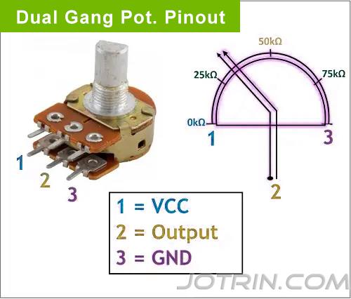
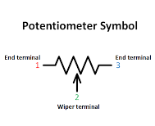
Demo: PWM to Analog
Potentiometer
A component that acts as both a variable resistor and a voltage divider.
Adjustable (Ω) allow quick current and voltage control. Applied in electrical knobs, sliders.
GND +VCC GND +VCC

Slide 22
Demo: PWM to Analog
+ Probe
3.3V
D10 Pin
Add components on breadboard connected like the right:
Compile and run the code in the IDE.
Use oscilloscope to measure the PWM signal.
Use oscilloscope or DMM to measure the voltage across the capacitor and notice how it is close to constant.
Low pass filter filters out the high frequencies leaving mostly DC voltage.
Vary the potentiometer and notice how the voltage rises and falls.
The ADC reads change in voltage and adjusts the duty cycle accordingly.
A0 Pin
GND
- Probe

Slide 23
Join us next meeting for Embedded Programming!
Nothing new is needed for next week. Any Questions?

